Slide 1
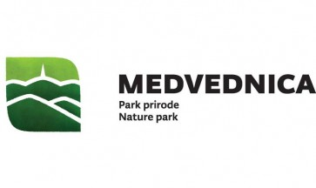
NATURA 2000 CROATIA

Slide 2
Natura 2000
Natural world knows no artificially created boundries. Plants disseminate freely and animals migrate over the borders with ease. In order to protect the natural world, people are also required to cross those borders.
European Union has devised a way to protect its flora and fauna through Natura 2000 network. The network includes areas important for conservation of endagered species and habitat types throughout the continent.

Slide 3
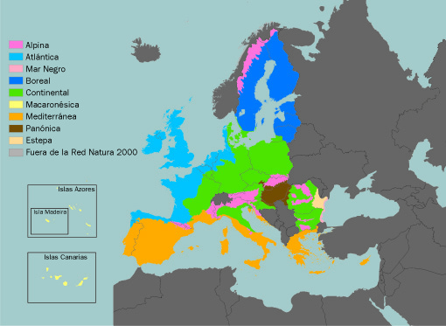
This ecological network was designed in order to try and conserve more than 1000 rare, endangered and endemic species of plants and animals and 230 natural and semi-natural habitats in more than 3000 Natura areas.

Slide 4
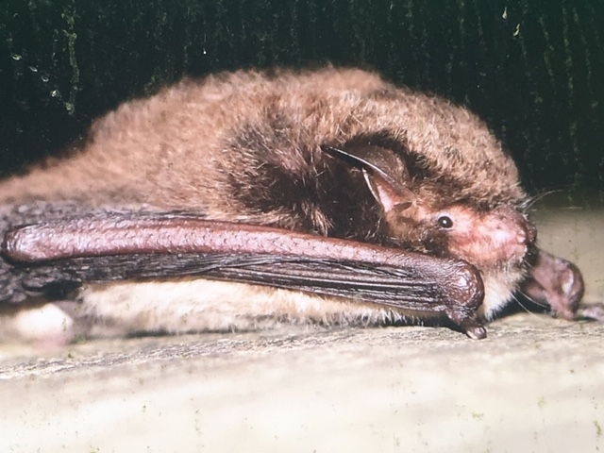
Natura areas are chosen based on scientific criteria and are rooted in two important European directives that are basis for nature protection within the European Union – Bird Directive and Habitats Directive. Important habitat types, plant and animal species are named as Natura species and are listed in annexes of those directives. Those species could be considered as „ambassadors“ of nature whose presence, abundance and conservation status in a selected area qualifies the area as a candidate for addition in Natura 2000 network.

Slide 5
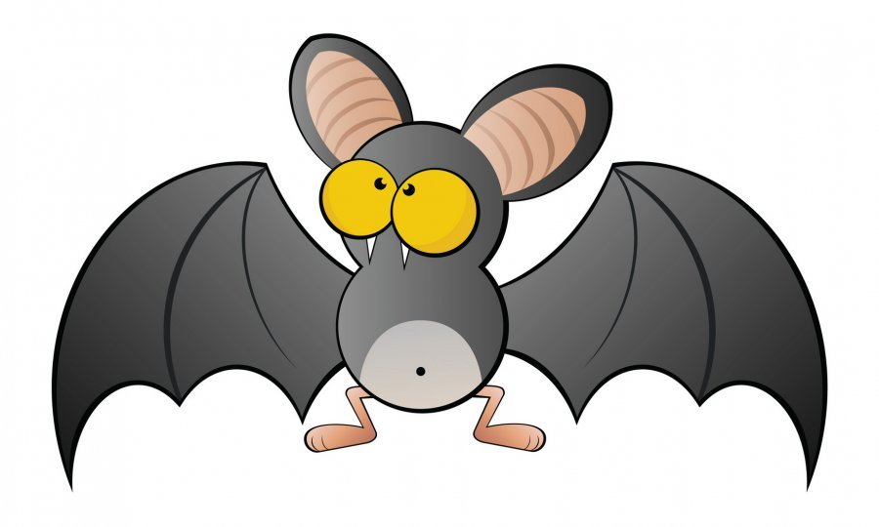
NATURA 2000 CROATIA

Slide 6
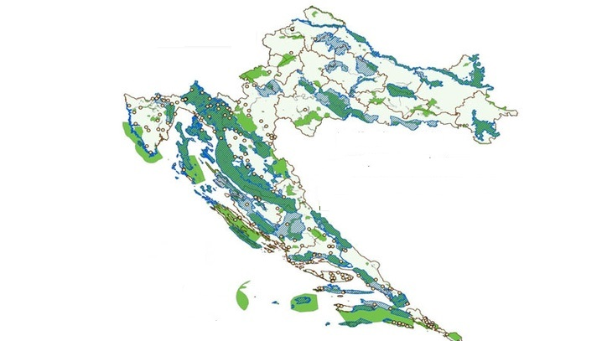
http://www.bioportal.hr/gis/

Slide 7
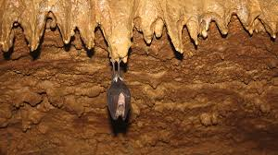
Croatia is rich in plants and animals life.
Many species and areas are under national or international protection.
Bat in Veternica cave, Medvednica, Zagreb, Croatia
Protected areas today account for 8.54% of the total area of ​​the Republic of Croatia.
12.22% of the land territory and 1.94% of the territorial sea.
Most of the protected areas are nature parks (4.90% of the total state territory).

Slide 8
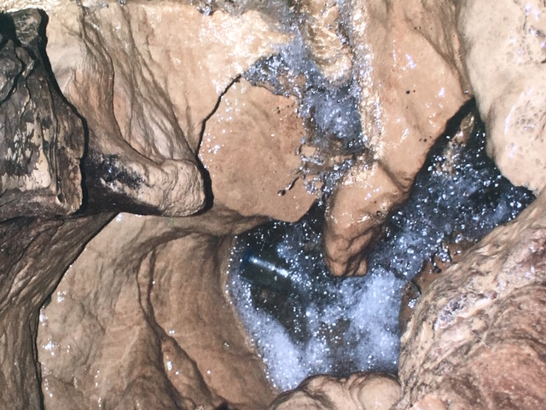
NATURAL „AMBASSADORS“ OF MEDVEDNICA
A STEP TOWARDS UNDERGROUND
Have you ever wondered what the passage to the underground looks like?
If you keep going down this mountain path, you will get to a place where the passage descends underground.

Slide 9
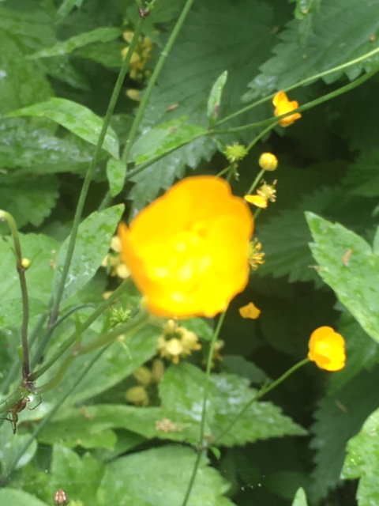
THE UNDERGROUND BEAUTY OF MEDVEDNICA
Veternica is the sixth longest cave in Croatia and 7128 m of canals have been explored thus far.
The importance and distinctiveness of the Veternica cave was legally confirmed in the year 1979., when it was declared a geomorphological monumental of nature.
Its ingabitants were once cave bears and many other animals which lived during the ice and interglacial ages, such as leopards and rhinoceros.
Today, only bats and organisms adopted to life in dark, cold and damp environments live in it.

Slide 10
Map of Veternica cave

Slide 11
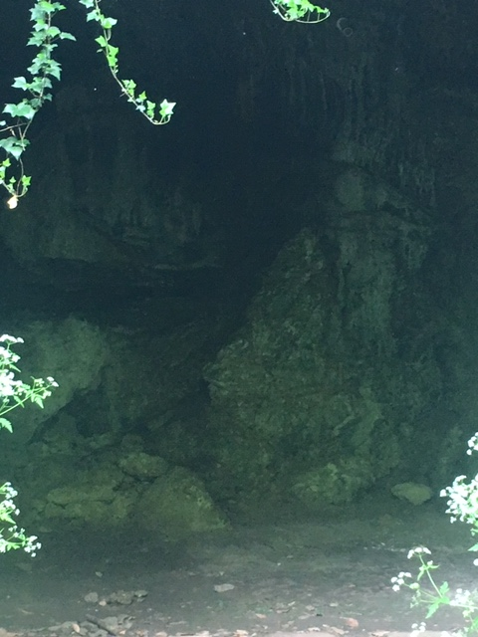
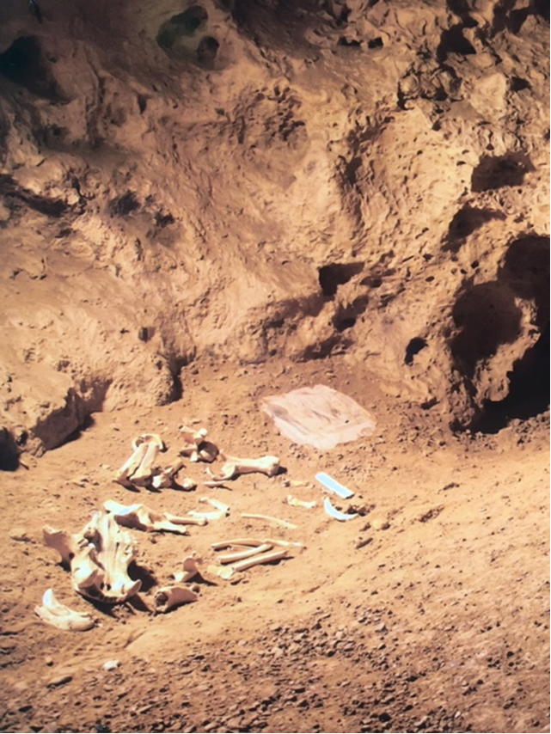

Slide 12
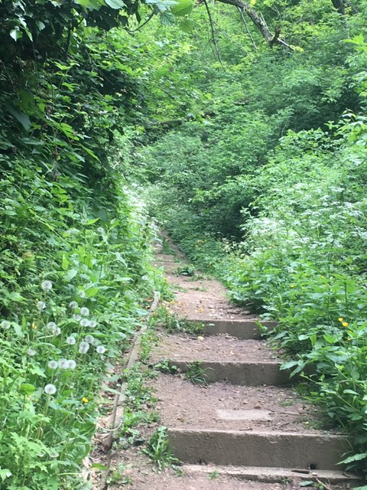
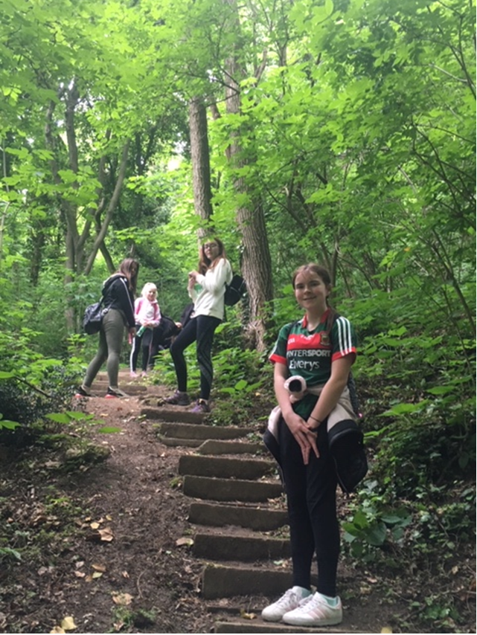
The Veternica Cave is located within the Park area. This cave is a habitat for 18 different bat species, which is an extremely high number considering the fact that 35 species of bats live in Croatia.

Slide 13
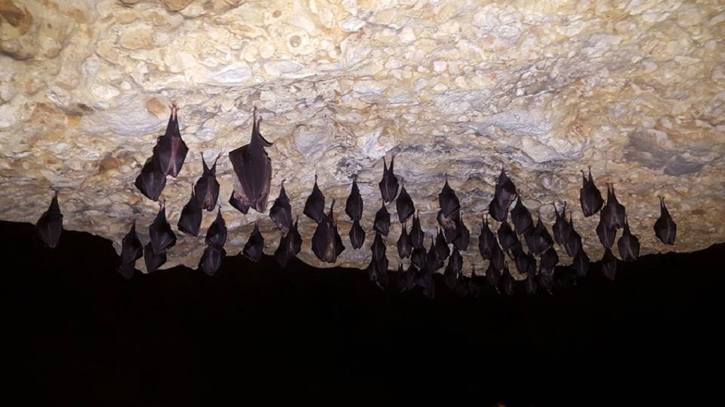
Even though they have very few natural predators (mostly owls and cats), bats are very endangered. Their most significant enemy are humans because they change bats’ habitats with different economic projects (knocking down old trees, water management projects etc.), excessively use pesticides and disturb or destroy bats’ summer or winter habitats.

Slide 14
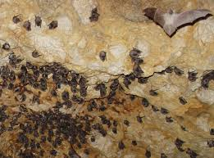
Species of bat in Veternica cave (some of them a protected by Nature 2000):
Veliki potkovnjak (Rhinolophus ferrumequinum)
Širokouhi mračnjak (Barbastella barbastellus)
Mali potkovnjak (Rhinolophus hipposideros)
Kasni noćnjak (Eptesicus serotinus)
Resasti šišmiš (Myotis nattereri)
Dugouhi šišmiš (Plecotus auritus)
Oštrouhi šišmiš (Myotis blythii)
Riječni šišmiš (Myotis daubentonii)
Veliki šišmiš (Myotis myotis)
Dugokrili pršnjak (Miniopterus schreibersi)
Južni potkovnjak (Rhinolophus euryale)
Vlasasti šišmiš (Myotis emarginatus)
Velikouhi šišmiš (Myotis bechsteinii)
Dugoušan (Plecotus macrobularis)

Slide 15
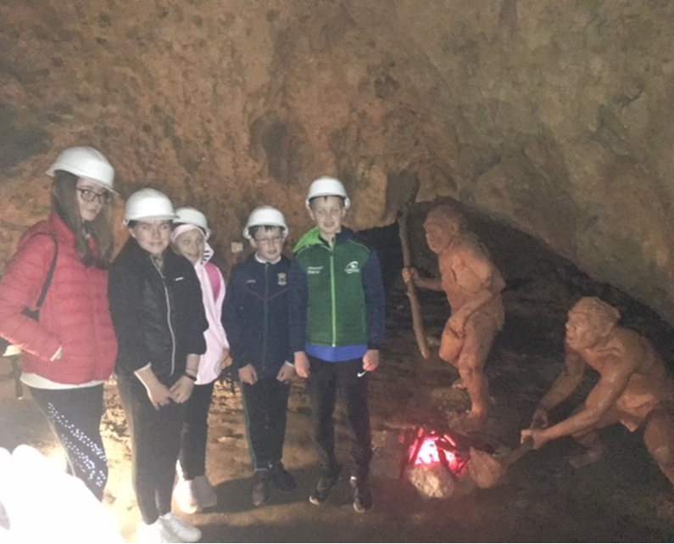

Slide 16
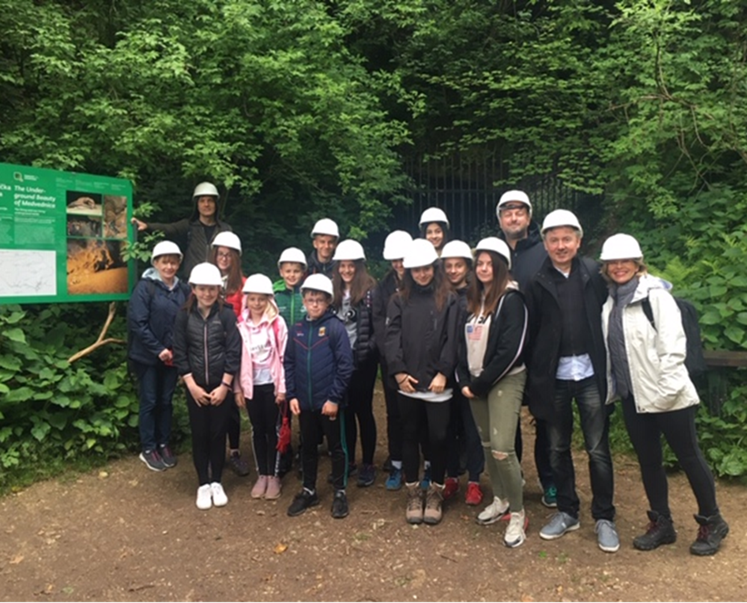

Slide 17
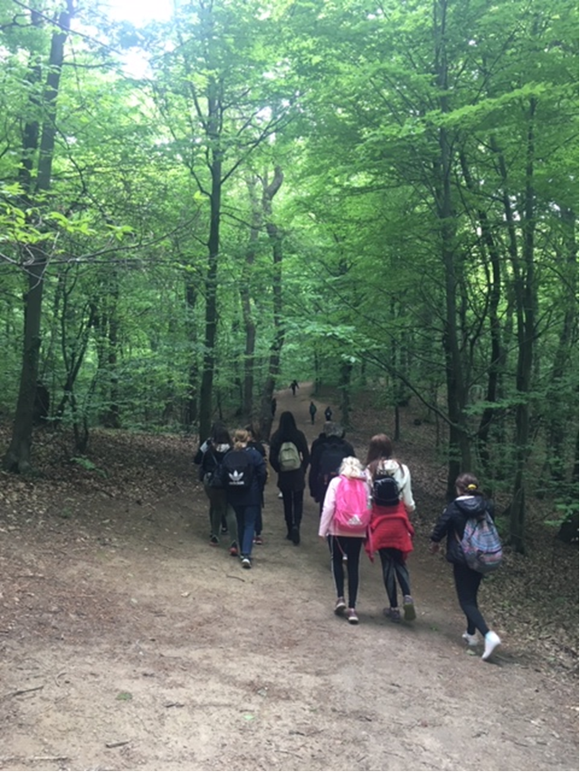

Slide 18
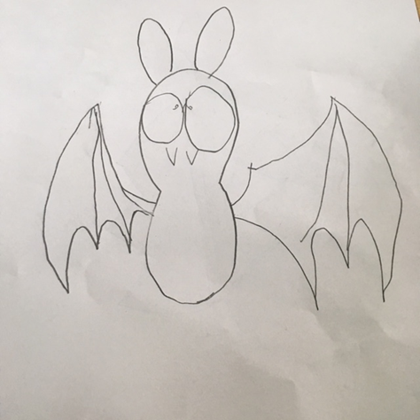
BAT IN CLASS

Slide 19
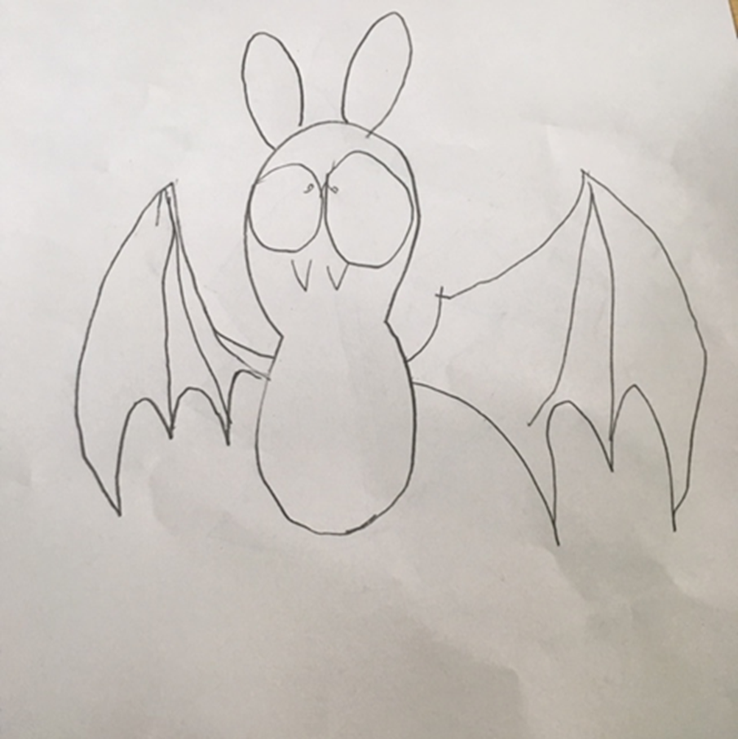
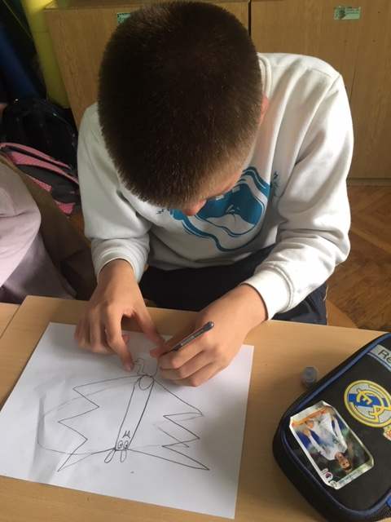
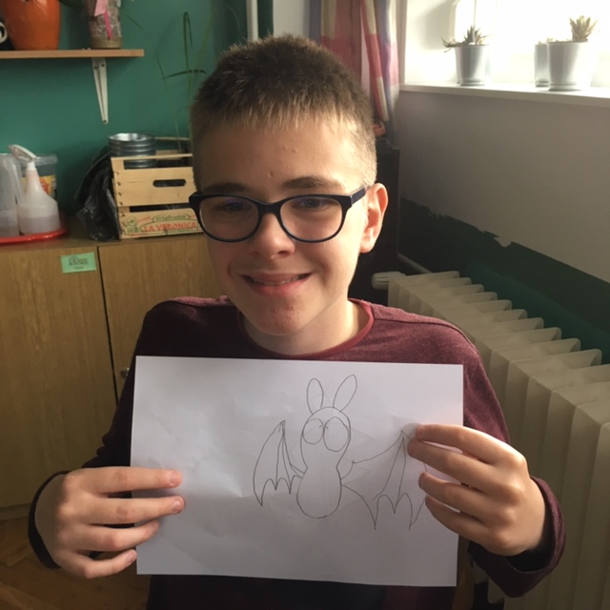

Slide 20
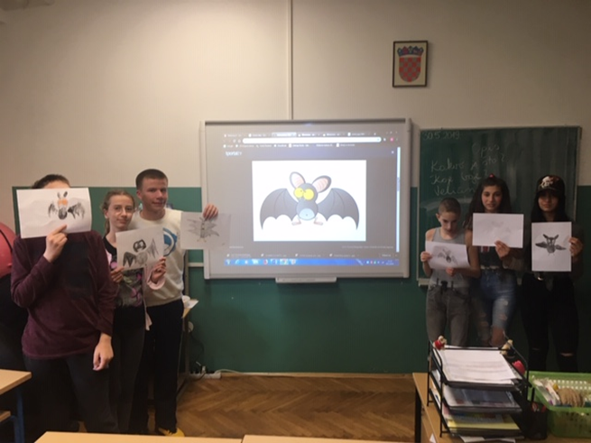
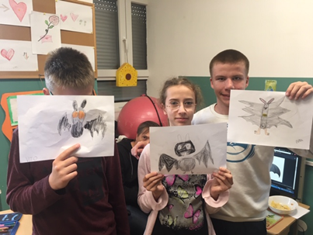
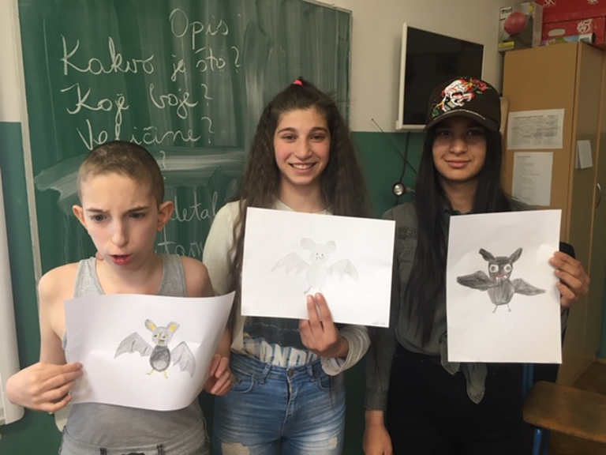

Slide 21
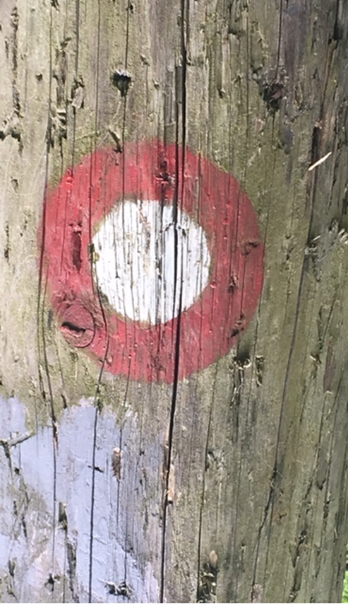
ON THE RIGHT TRACK!

